Slide 1

Transportation
Committee –
Quarterly Update
Mayor Andre Dickens
Commissioner Josh E. Rowan, PE
1
ATLDOT
May 2022

Slide 2
Safety Moment
Lighting Update
Pothole Posse Update
TSPLOST 1.0 Update
2
ATLDOT

Slide 3
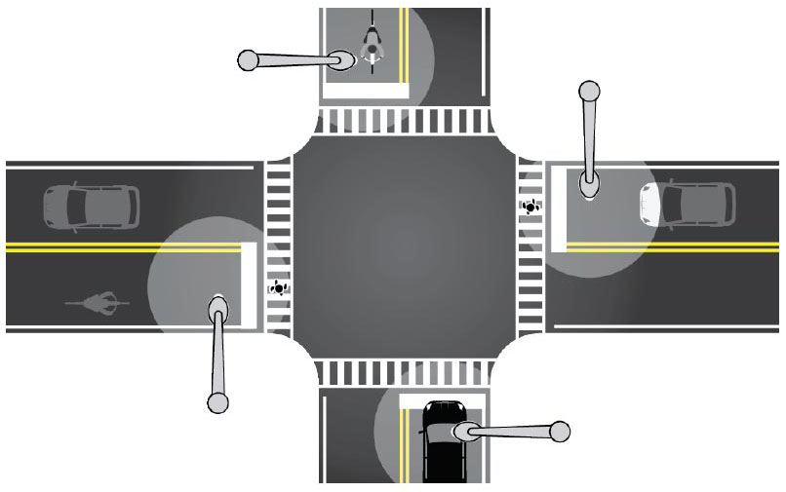
Lighting Update
Nighttime fatality rate is 3x daytime
Reduce 42% nighttime ped injury
Reduce 38% nighttime crashes at urban intersection
Reduce 28% nighttime injury crashes on urban highways
3

Slide 4
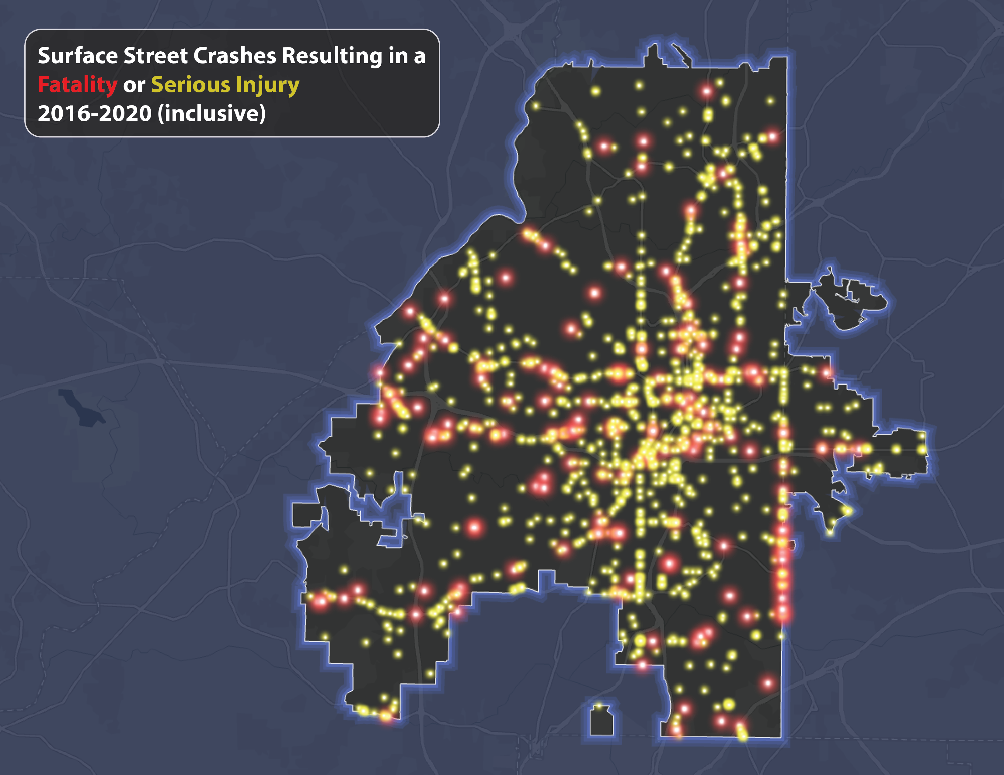
4
ATLDOT
4

Slide 5
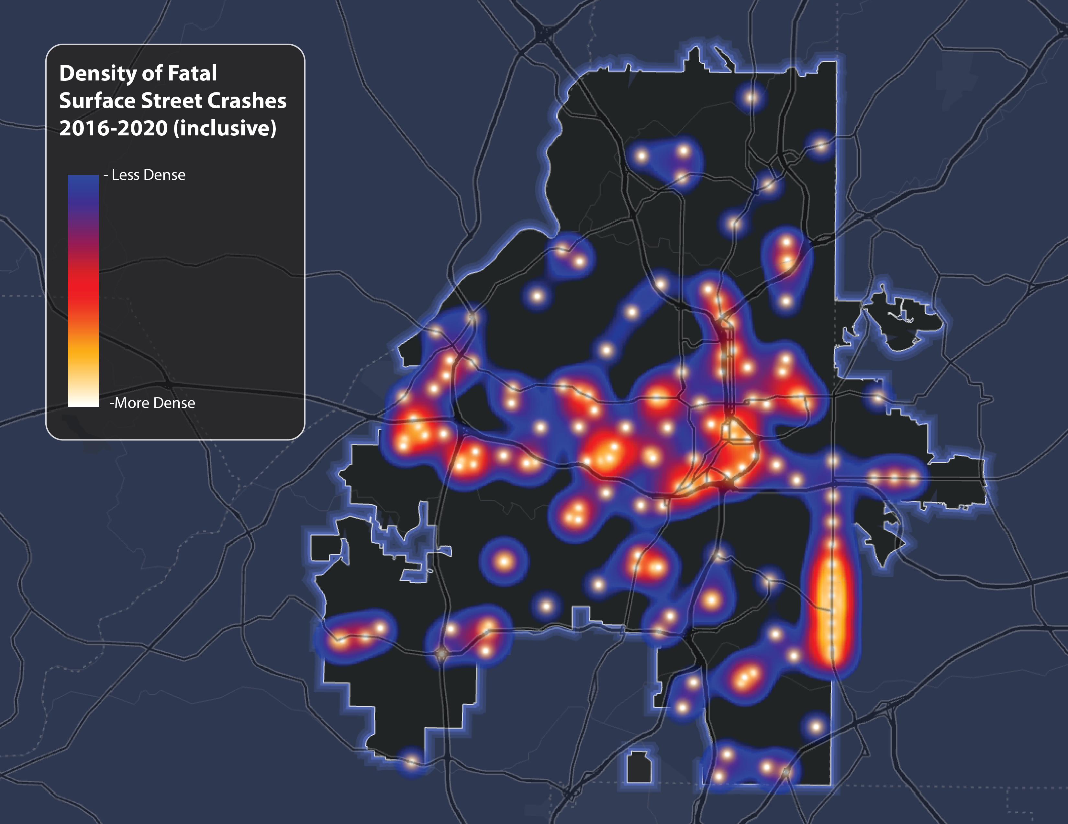
5
5
ATLDOT

Slide 6

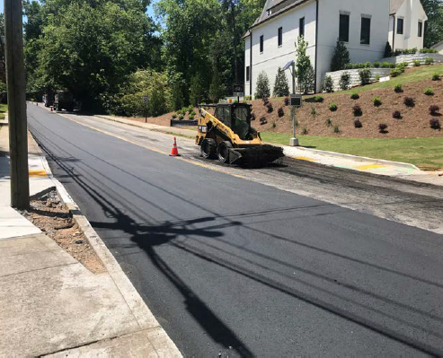
Streetlights
6
ATLDOT

Slide 7
Light Up the Night Summary
PHASE 0 GPC Streetlight Audit
PHASE 1 Sell 10k COA Streetlights to GPC (own, repair, upgrade)
PHASE 2 Re-negotiate interstate lighting maintenance (ON HOLD)
PHASE 3 Install 10k new/replacement streetlights to be leased from GPC
7

Slide 8
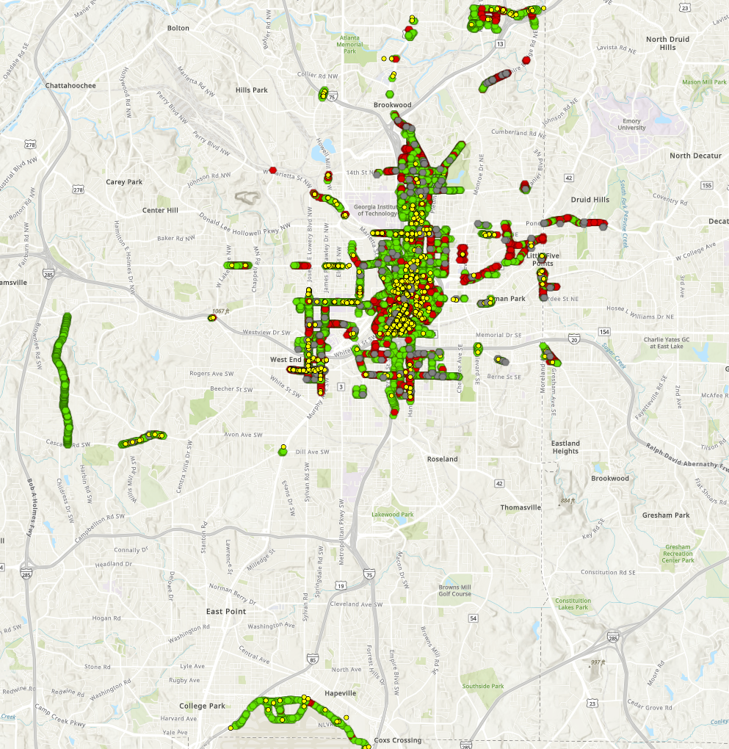
City-Owned Streetlights
Approximately 9,317 lights to be sold to GPC
Audit found 12% were not functioning
Lights will be upgraded/repaired by GPC
8

Slide 9
Light Up the Night - Progress
Areas of focus based on crime/crash rates
2,000 new/replacement lights installed
3,000 new/replacement lights in engineering
COA / GPC Agreement before Transportation Committee today
PAUSE
“Maintenance Blitz” – Transfer ownership of 10k lights to GPC; repair/upgrade included
Finalize focus areas for remaining 5,000 lights
ATLDOT/GPC will complete in 2 years what would have likely taken 10 years
Quick lighting audit comment
9

Slide 10
Pothole
Posse
Portion of
Presentation
10
ATLDOT

Slide 11
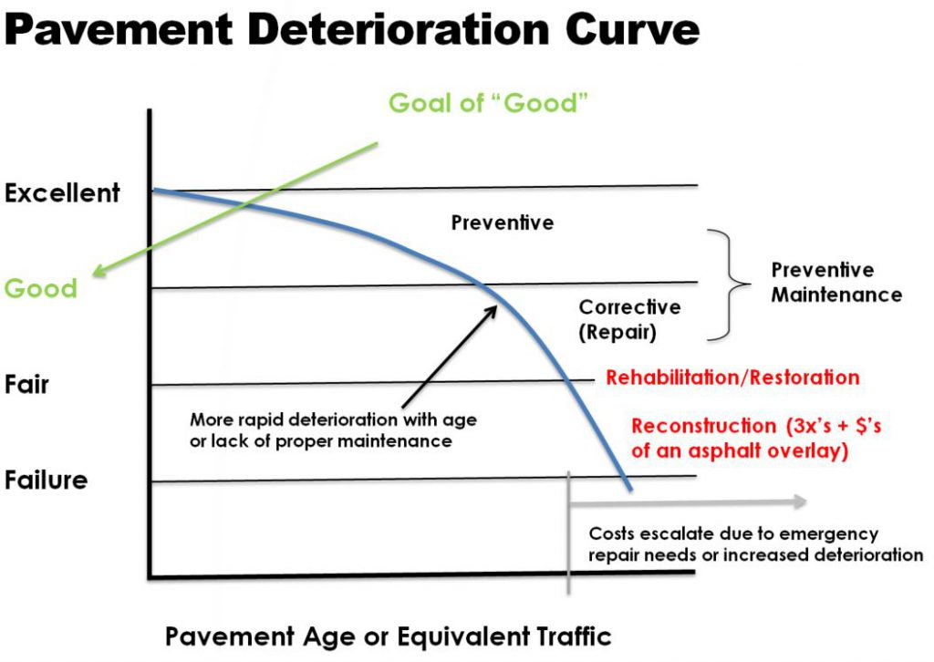
40%
60%
11

Slide 12
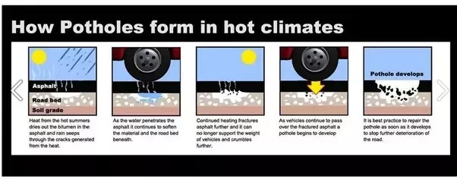
Why Drainage is Important.
12

Slide 13
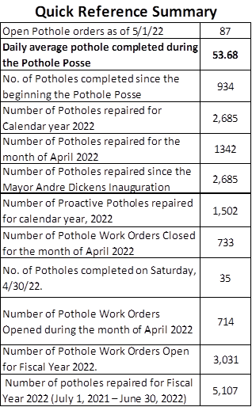
Pothole Posse and Pavement Preservation
13

Slide 14
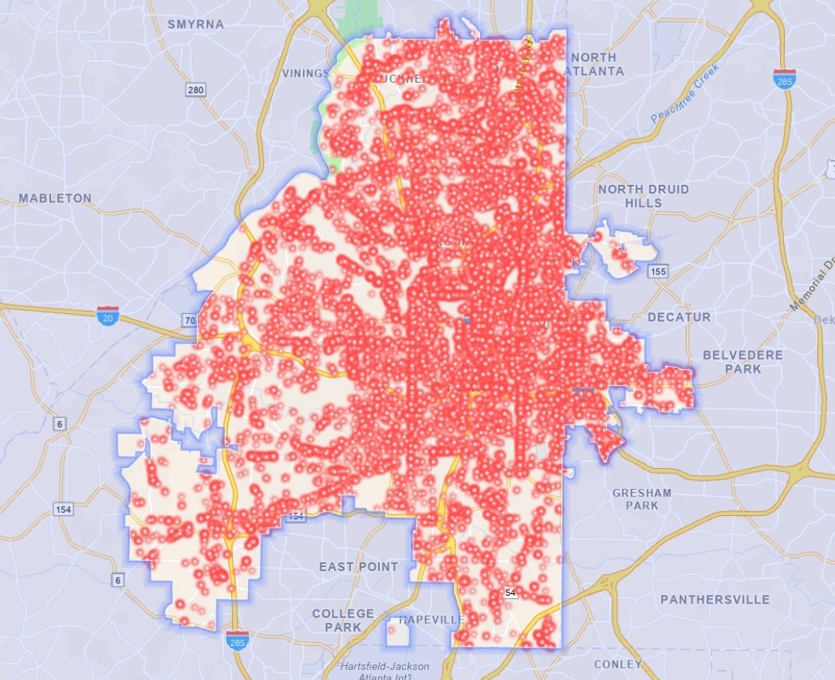
ATL Potholes
3-year window
19,434 potholes repaired
14

Slide 15
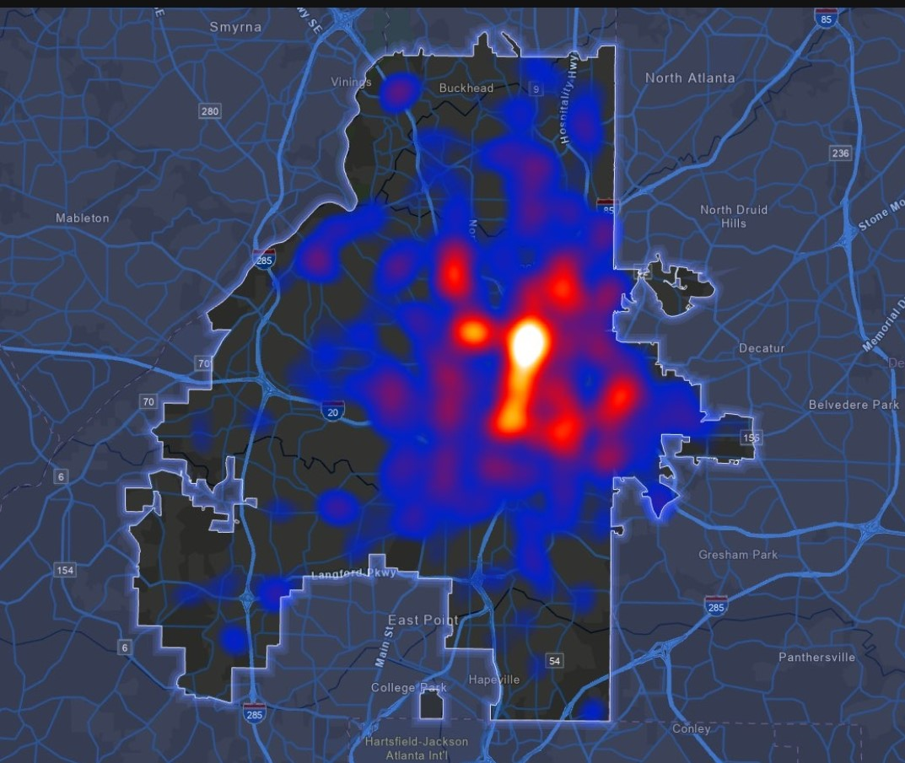
Pavement Investment
15

Slide 16
TSPLOST 1.0
Revenue
FINAL
16
ATLDOT

Slide 17
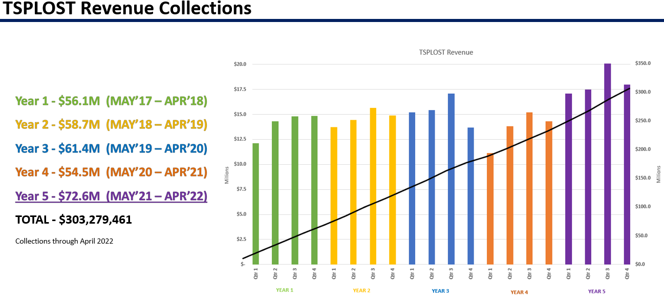
17

Slide 18
TSPLOST 1.0 Lessons Learned
Overhead Percentage must be constantly monitored (Staff and PMT)
Design as Percentage of Construction is a vital sign
Evaluate Designers on Engineer Estimate versus Bid Price (Design to Budget)
Evaluate Designers on Percent Change Orders due to design errors/omissions
Need more technical/design resources. Competition is good (New A/E)
Be slightly pessimistic with revenue forecast and cash flow projections
Balance budget to revenue forecast, track changes, and publish for transparency
XPI is an excellent metric for capturing cost and time factors
Regularly evaluate “Trigger-to-NTP” delivery time
Best value construction selection criteria are best for city
Promote contractor competition and creation of new DBE contractors
Periodically update construction contract to address changing risk
Once invoice is approved, pay quickly. Never make partial payment
Do not entertain unjustified change orders
Need sense of urgency during punch list and closeout
Community engagement is iterative and can vary by location.
Walkabouts and workshops are winners.
Conduct AAR for every completed project and publish results
18

Slide 19
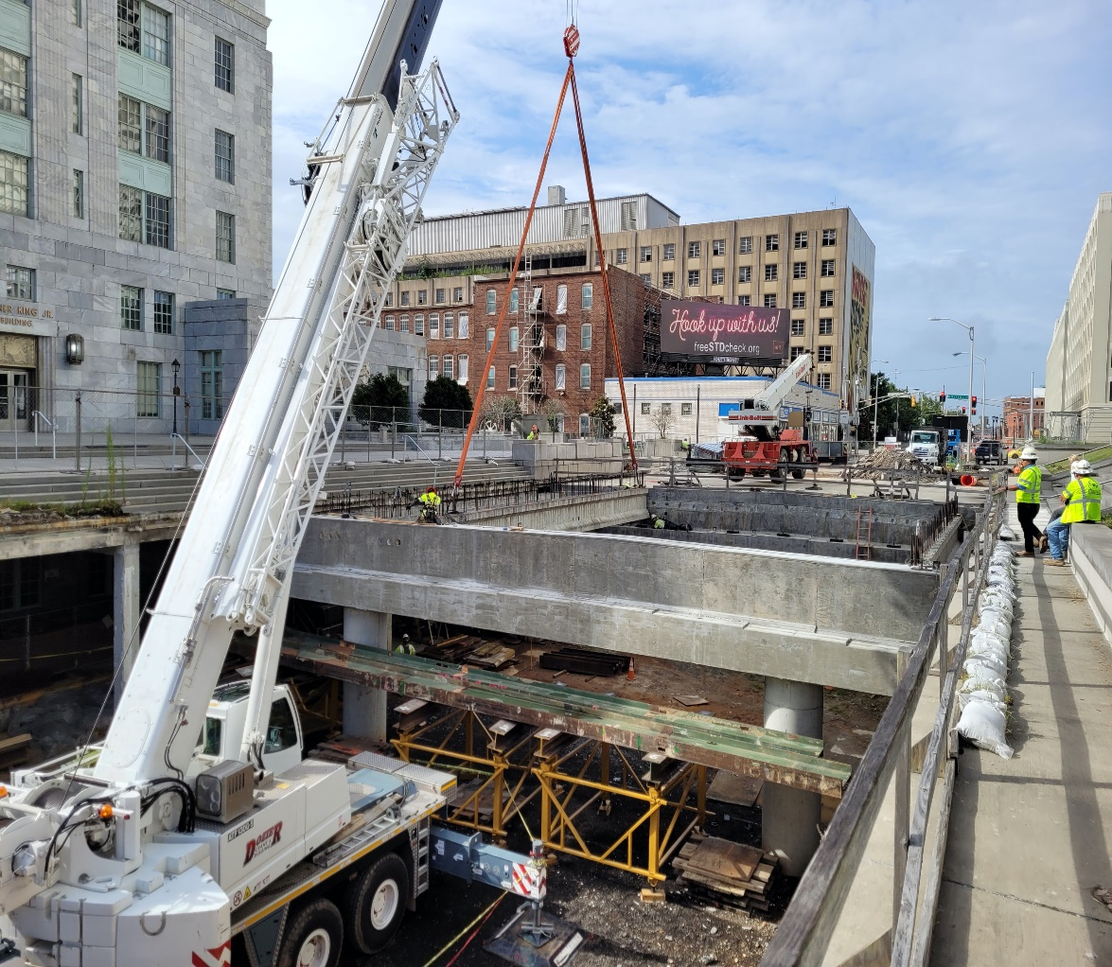
Conclusion
Our Values –
Safety
Service
Stewardship
Speed
19
ATLDOT

Slide 20
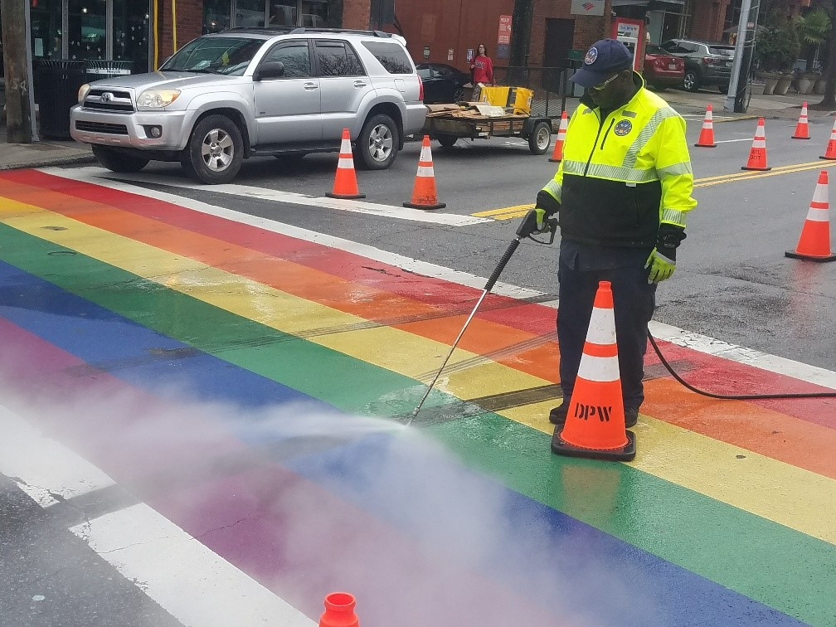
20

Slide 21
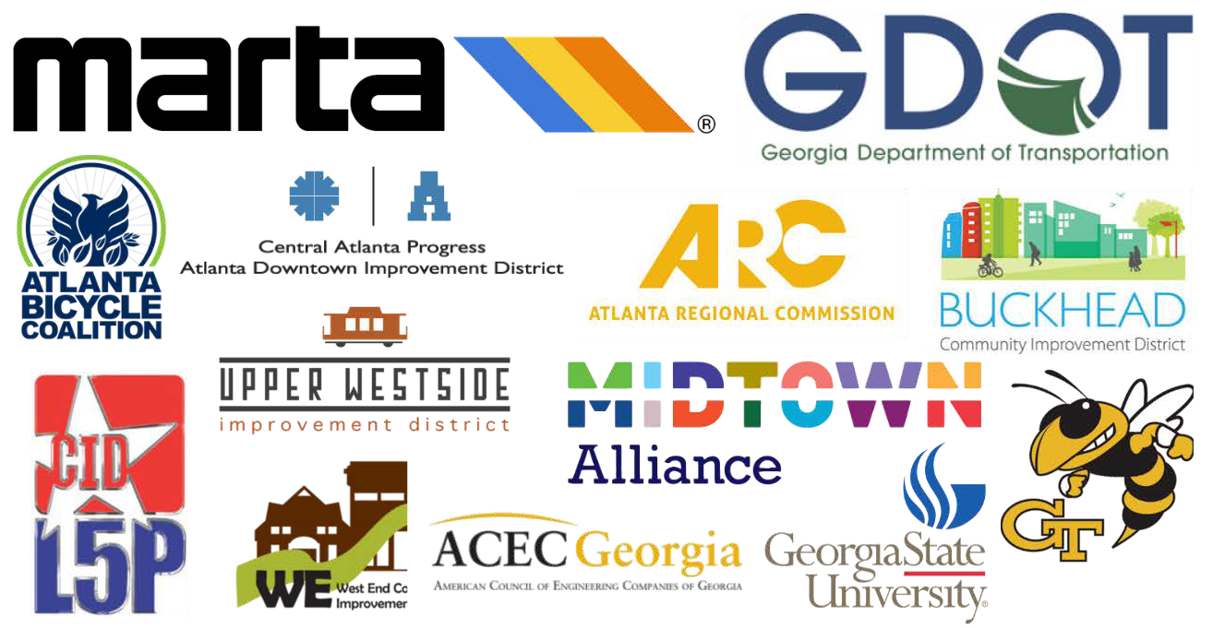

Our Partners
N P U
21
ATLDOT

